Slide 1
Reactive Programming
Project Reactor
20.05.2019

Slide 2

Index
01. Reactive Programming
Introduction
Generations
Reactive Streams API
02. Project Reactor
Introduction
Subscribe
Mono 🙈
Flux
Creation Operations
Combination Operations
Transformation Operations
Schedulers
Control Flow
Unit Testing
Logic Operations
Processors

Slide 3
Reactive Programming

Slide 4
Reactive Programming
Introduction
Reactive programming is paradigm alternative to imperative programming.
Imperative programming is very simple. You write a list of instructions to be executed.
But, what happend when an instruction execution takes a long time to finish?
I/O tasks are usually quite expensive in terms of time.
This kind of task implies:
BLOCKING TASK 😫
Most programming languages support concurrent programming but handle the lifecycle
of a big amount of threads is challenging.
Reactive programming describes a pipeline or stream through data flows.
A reactive stream processes data as it becomes available.

Slide 5
Reactive Programming
Introduction
https://www.reactivemanifesto.org/
Reactive systems are:
Responsive
Resilient
Elastic
Message Driven

Slide 6
Reactive Programming
Generations
David Karnok’s classification:
Zero generation (java.util.observable, callbacks)
First generation (Rx.NET, IObserver and IObservable interfaces)
Second generation (First implementations of Reactive Extensions: RxJava 1.X and Akka)
Third generation (Reactive Streams specification)
Fourth generation (Reactive API looks like 3rd generation but internally some operators change significantly. Project Reactor 3.0 and RxJava 2.x)
Fifth generation: Bidirectional reactive I/O operations over the streams.

Slide 7
Reactive Programming
Reactive Streams API
Reactive Streams defines four primary interfaces:
Publisher
Subscriber
Subscription
Processor

Slide 8
Reactive Programming
Reactive Streams API - Publisher
package org.reactivestreams
public interface Publisher<T> {
void subscribe(Subscriber<? super T> s);
}
The Publisher offers only one method to register the subscriber.
Publisher stands for a standardized entry point for a straightforward Publisher and Subscriber connection.

Slide 9
Reactive Programming
Reactive Streams API - Subscriber
package org.reactivestreams
public interface Subscriber<T> {
void onSubscribe(Subscription s);
void onNext(T t);
void onError(Throwable t);
void onComplete();
}
onSubscribe: Notify the subscriber that a publisher just started a subscription (through the Publisher.subscribe(Subscriber)method). This is also a way for the subscriber to keep a reference on the Subscription object provided.
onNext: Notify the subscriber a message was sent. If everything goes right, after having processed a message, the subscriber will usually invoke then Subscription.request(long).
onError: Notify the subscriber when a publisher is closed with an error state.
onComplete: Notify the subscriber when a publisher is closed

Slide 10
Reactive Programming
Reactive Streams API - Subscription
package org.reactivestreams
public interface Subscription {
void request(long n);
void cancel();
}
cancel: Used by a subscriber to cancel its subscription.
request: Used by a subscriber to request n messages to a Publisher.

Slide 11
Reactive Programming
Reactive Streams API - Processor
package org.reactivestreams
public interface Processor<T, R> extends Subscriber<T>, Publisher<R> {
}
A simple interface extending Publisher and Subscriber interfaces. In other words a Processor can acts as both a Publisher and a Subscriber.

Slide 12
Project Reactor

Slide 13
Introduction
Spring Team needs a High-Throughtput data processing. Specially for the Spring XD project (EOL). Reactor pattern that helps async event handling and sync processing. Project Reactor 1.x (2014)
Project Reactor 2.x -> Early 2015 Extract the eventbus and the stream features into separated modules. Fully compliant with Reactive Streams. Much more similar to the RxJava API.
Project Reactor 3.x -> Mid 2016. Targets Java 8. Avoid callback hell and deeply nester code. Efficient data manipulation.

Slide 14



Links
https://github.com/Telefonica/cto-spring-webflux-training
https://codeshare.io/
https://projectreactor.io/docs/core/release/api/reactor/core/publisher/package-summary.html

Slide 15
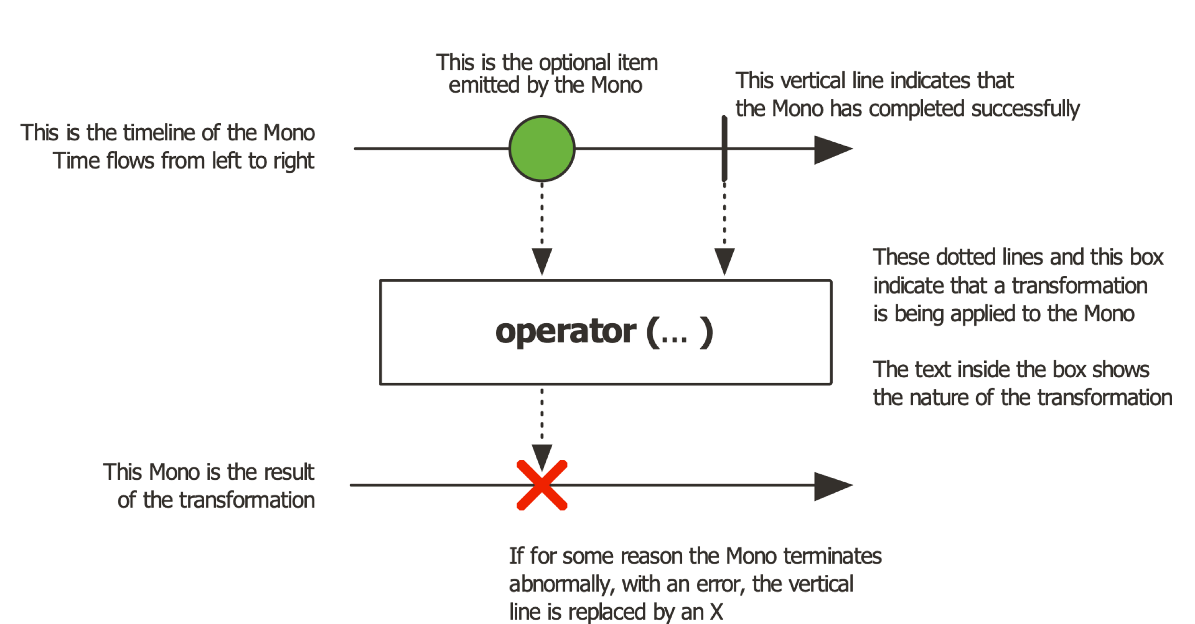
Mono<T>
https://projectreactor.io/docs/core/release/api/reactor/core/publisher/Mono.html
Mono type defines a reactive stream that can produce at most one element.
🙈

Slide 16

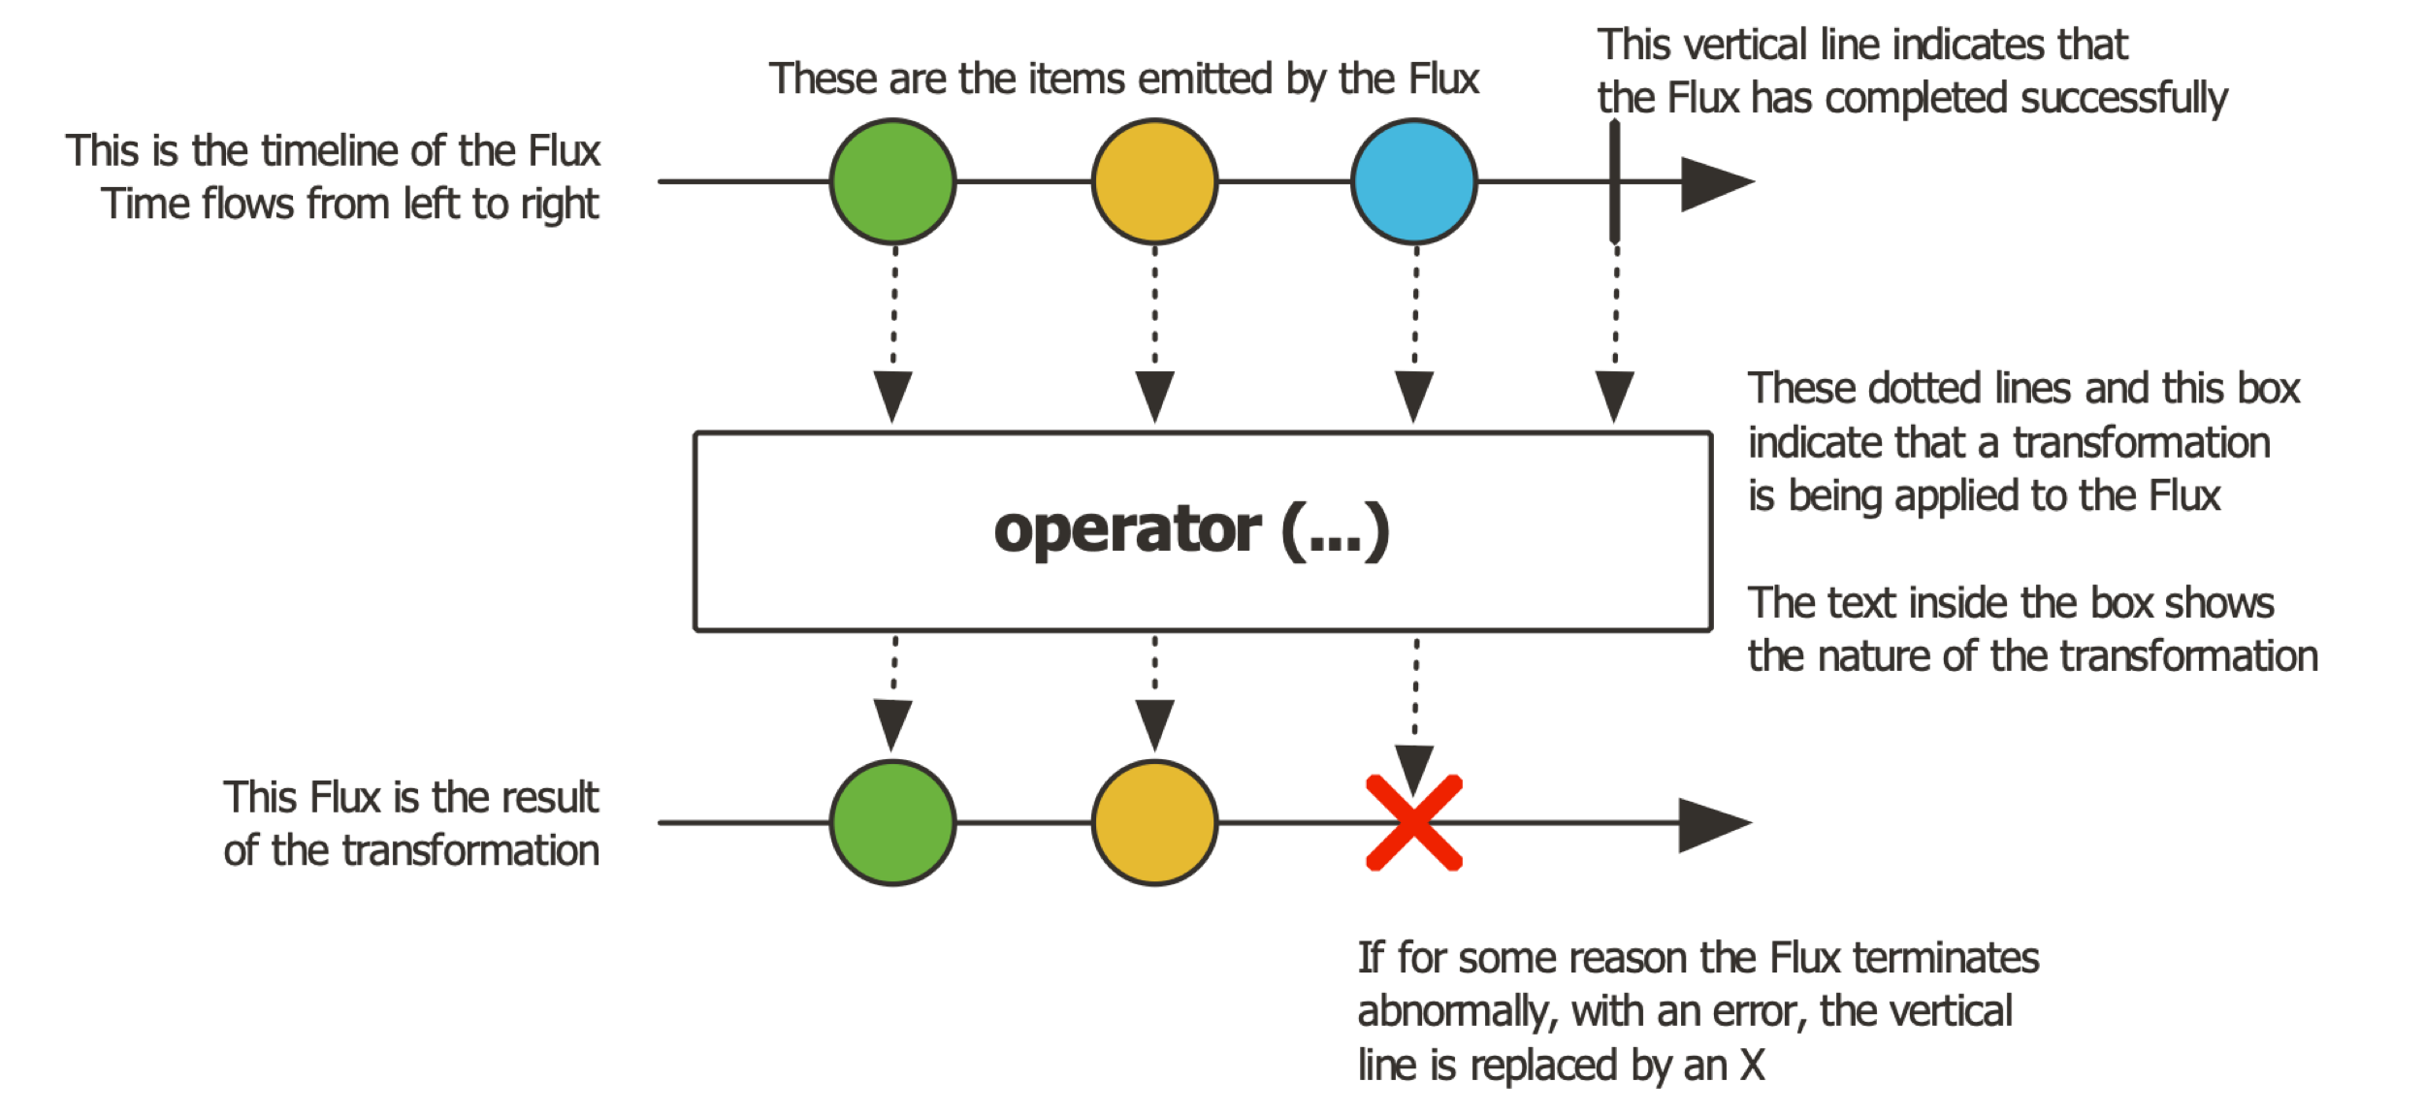

Flux<T>
https://projectreactor.io/docs/core/release/api/reactor/core/publisher/Flux.html
Flux type defines a reactive stream that can produce zero, one, or more elements.

Slide 17
Subscribe
subscribe(Subscriber<T> subscriber);
Subscribe(Consumer<T> dataConsumer, Consumer<Throwable> errorConsumer, Runnable completeConsumer, Consumer<Subscription> subscriptionConsumer);
dataConsumer is invoked on each value (onNextSignal)
errorConsumer handles the onError signal
completeConsumer handles the onComplete signal
subscriptionConsumer allows all elements in Reactive Stream be consumed.

Slide 18
Creation Operations
.just()
.empty()
Flux.range()
Flux.fromIterable(Iterable iterable)
Flux.fromStream(Stream stream)
Code Order:
CreatingReactiveFlux1.java
CreatingReactiveFlux2.java
ExerciseCreatingReactiveMono1.java
CreatingReactiveFlux3.java
CreatingReactiveFlux4.java
ExerciseCreatingReactiveMono2.java

Slide 19
Combination Operations
.merge()
.concat()
.zip()
.zipWith()
.zipWhen()
Code Order:
CombiningReactiveFlux1.java
CombiningReactiveFlux2.java
ExerciseCombiningReactiveMono1.java

Slide 20
Transformation Operations
.skip()
.take()
.filter()
.distinct()
.map()
.flatMap()
.flatMapMany()
Code Order:
TransformingReactiveFlux1.java
TransformingReactiveFlux2.java
TransformingReactiveFlux3.java
ExerciseTransformingReactiveFlux1.java
ExerciseTransformingReactiveFlux2.java
ExerciseTransformingReactiveFlux3.java
TransformingReactiveFlux4.java

Slide 21
Schedulers Policies
.subscribeOn(Scheduler)
.inmediate() -> Executes the subscription in the current thread
.single() -> Executes the subscription in a single, reusable thread. Reuses the same thread for all callers.
.newSingle() -> Executes the subscription in a per-call dedicated thread.
.elastic() -> Executes the subscription in a worker pulled from an unbounded., elastic pool. Worker are created and disposed as needed.
.parallel() -> Executes the subscription in a worker pulled from a fixed-size pool, sized to the CPU cores.

Slide 22
Control Flow
.switchIfEmpty()
.then()
.thenReturn()
.onError()
Code Order:
ControlFlowReactive1.java
ControlFlowReactive2.java
ExerciseControlFlowReactive1.java

Slide 23
Unit Testing
StepVerifier.create(Publisher)
.expectNext()
.expectNextMatches()
.thenConsumeWhile()
.verifyComplete()
Code Order:
NormalReactiveTest.java

Slide 24
Logic Operations
.all()
.any()
Code Order:
LogicReactiveTest.java

Slide 25
Processors
EmitterProcessor
Multiple subscriptions
ReplayProcessor
Multiple subscriptions
and replay last events
Code:
ProcessorReactiveTest.java
TopicProcessor
Multiple subscriptions
threads policy
WorkQueuProcessor
Multiple subscriptions, threads policy and data demux

